Slide 1
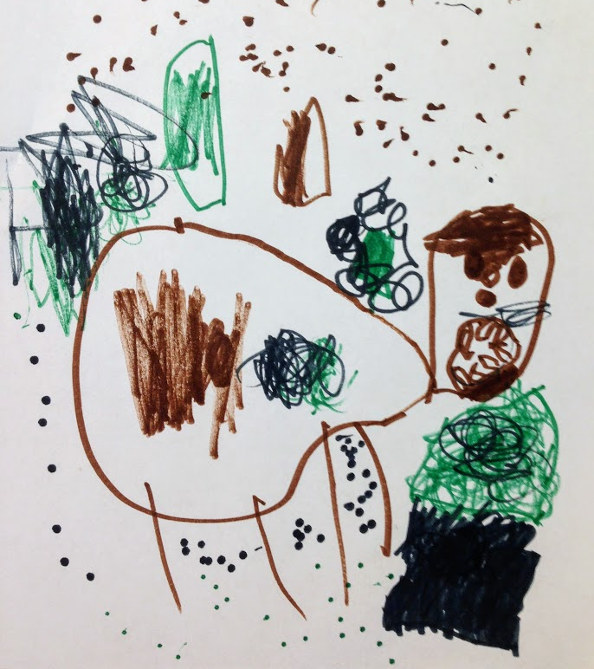
The Coyote and The Maple Tree
Written and Illustrated by:
Rayhan, Pippa, Naomi, Mia, Lucy D, Gavin, Gigi, Teddy, Rosie, Jimmy, Colm, Lucy L, Ceci, Cooper, Ava, John, Nate, Siddharth, Ira, Eleni, Harper, Marlow, Earl, Emily, Sammy, Miya, Lou, West, and Arden
March and April, 2018

Slide 2
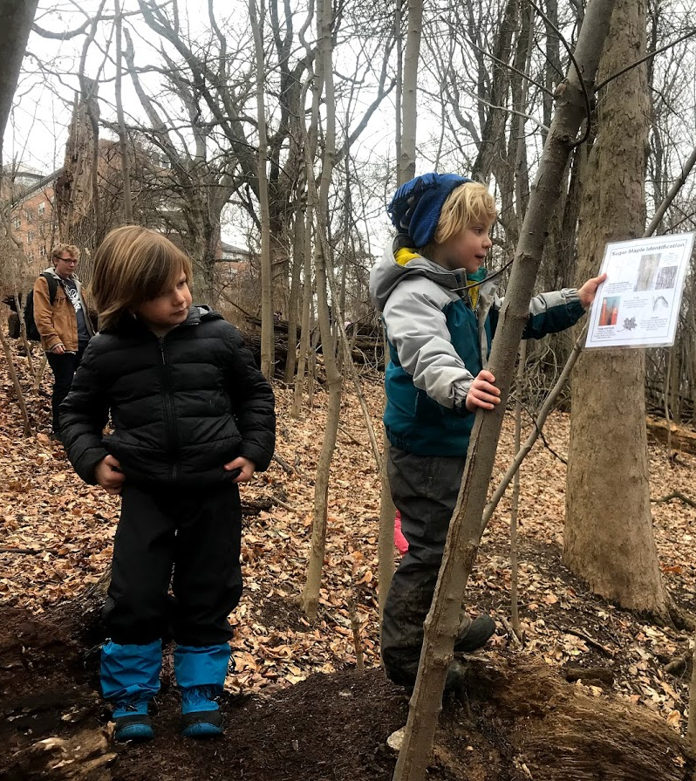
Once upon a time, there were Little Leafers who wanted to tap a maple tree. They learned how to identify a sugar maple and marked the trees with yellow string in the Maple Tree Grove.

Slide 3
The next day, they walked to the forest. They carried buckets, sap lines, taps, and a drill.

Slide 4
They sang to the tree.
Good morning, Maple Tree, strong and tall!
It’s a maple sugaring day
Sunny warm days
Frosty cold nights
Your sap will flow our way!

Slide 5
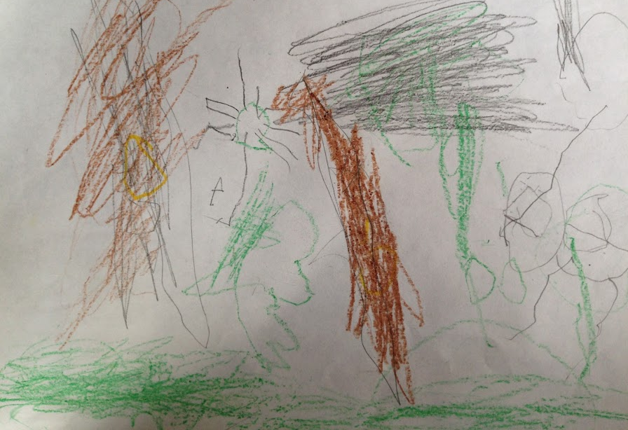
They measured the diameter. The tree could support 3 taps because it was bigger than 36 inches around! They set up the taps in the tree.

Slide 6
That night, there were reports of rabid coyotes in our community. Coyotes with rabies were on the attack! Because these animals were sick, they were not hiding from humans. Their sickness made them act dangerously. Everyone was to remain inside as much as possible.

Slide 7
The Little Leafers could not check the buckets at the maple tree for three loooooong weeks.

Slide 8
During this time, they learned about coyotes. They learned that coyotes eat deer, mostly come out at dawn and dusk, and even live in cities! Can you remember other facts about coyotes?

Slide 9
They wrote a song
Awoooo, coyote coyote coyote
I am a coyote and I have sharp claws
I have a weapon and its my teeth and paws
I am a coyote
In a rock and roll band!
-Naomi, John and Siddharth

Slide 10
They learned a mantra
Be brave, stand tall and still.
Do not turn your back to them.
Do not run.
Don’t fear them but respect them and they will see that you too are an animal of this forest.

Slide 11
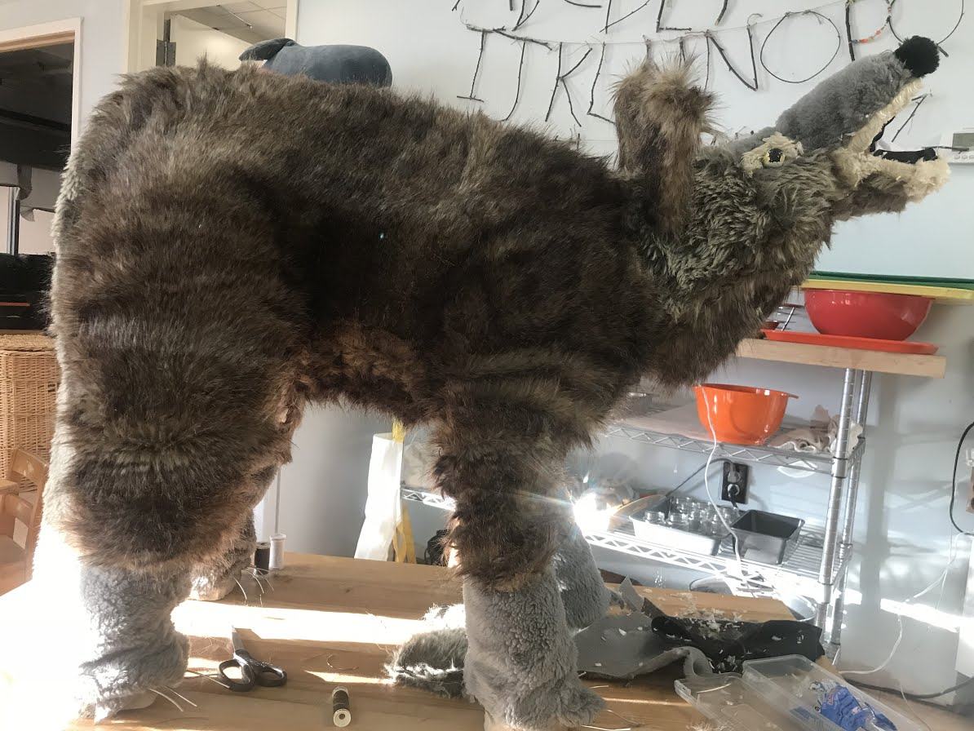
They created a life-size coyote!!!!

Slide 12
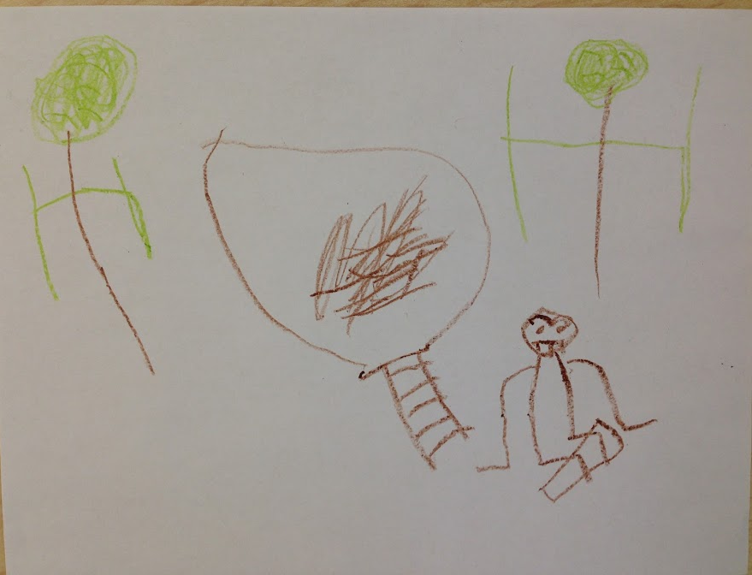
At circle time, Lucy Dale said she went to the park and there was a sign. It said, “Coyote.” Children couldn’t play in the parks!! Naomi said the police were trying to put the sick coyotes in coyote jail. Colm said that police officers had a stick they could point at the coyotes to make them dizzy. They learned that the town officials hired trappers to trap the rabid coyotes.

Slide 13
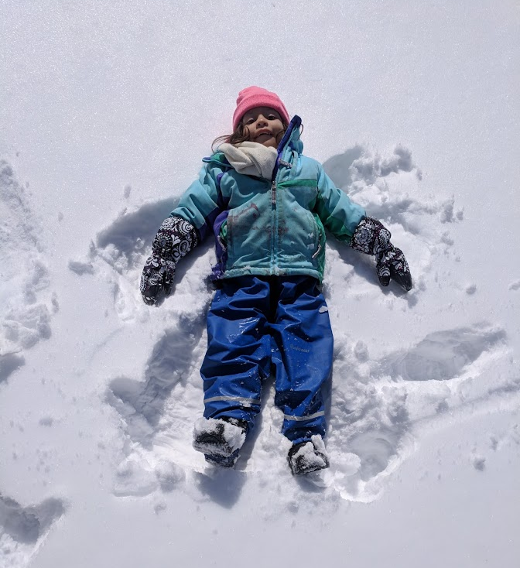
The children wondered, “Would the coyotes drink the maple sap?!?” They waited and waited. There were a few snowstorms but the children could not sled on The Great Hill. The sick coyotes might run out from behind the bushes!

Slide 14
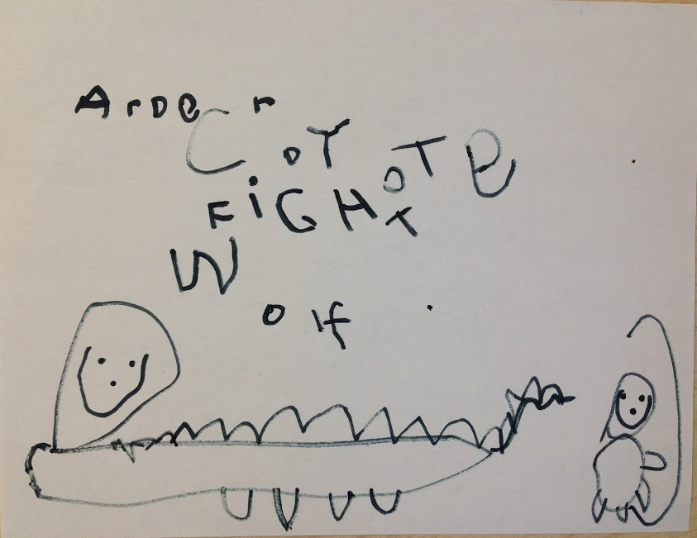
After some time, it was again safe to walk to the Maple Tree Grove. Coyotes had not been seen for three weeks. Naomi said, “We fought them and they aren’t in our world anymore. They were too wild for us.”

Slide 15
Before returning to the woods, they wondered what they would find.
Rayhan believed the buckets would be full because it had been a long time.
Arden and Siddharth thought the coyotes had tried the sap.
Ira thought the coyotes had brought the buckets with the sap to their den.
Ava believed the coyotes drank all the sap.
Theresa wondered if the sap had been the coyote’s medicine.
Ali said she would be surprised if the buckets were still there.

Slide 16
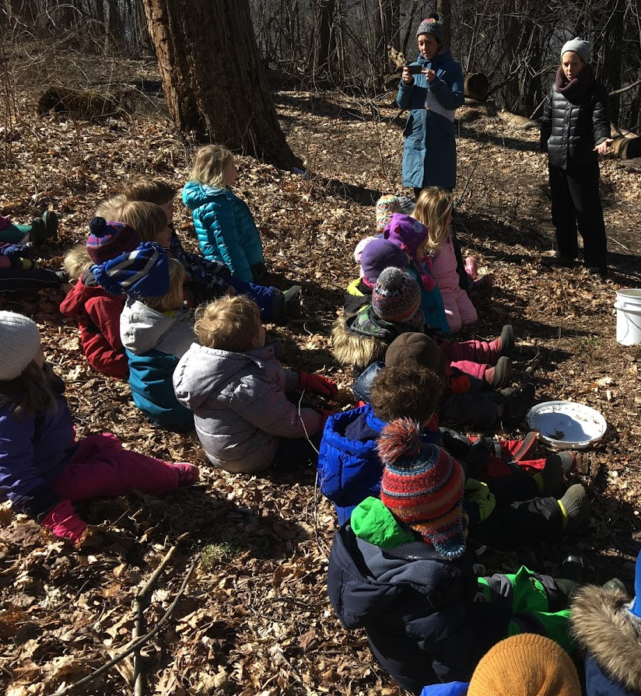
The Little Leafers walked to the Maple Tree Grove. They stayed together. Their teachers carried clubs (just in case.) What did they find? The buckets were still there. They were overflowing!

Slide 17
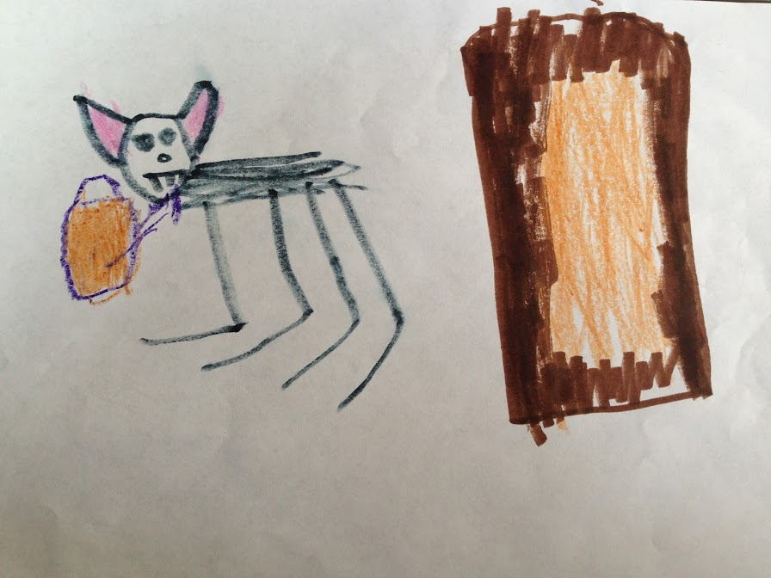
And to this day, they still wonder:
Did the coyotes drink the sap?

